Slide 1
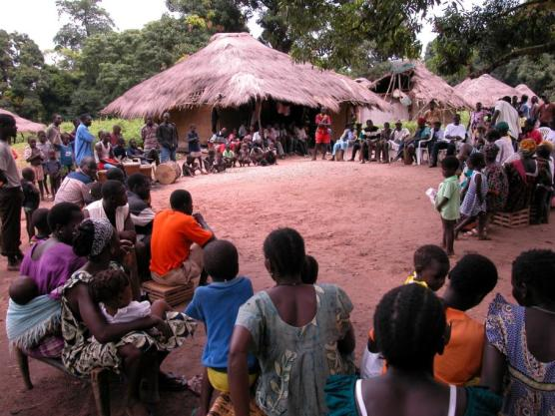
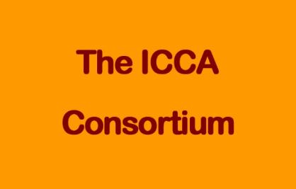
Methods and tools used by ICCA Consortium for documenting and visualizing indigenous peoples and local communities contribution to biodiversity conservation by their collective action in territories and areas conserved by indigenous peoples and local communities (ICCAs)
Dialogue Workshop on Assessment of Collective Action of Indigenous Peoples and Local Communities in Biodiversity Conservation and Resource Mobilization
11-13 June 2015 Panajachel, Guatemala
Conveners: Government of Guatemala and the CBD Secretariat
Carmen Miranda, Regional Coordinator of the ICCA Consortium cemirandal@gmail.com

Slide 2
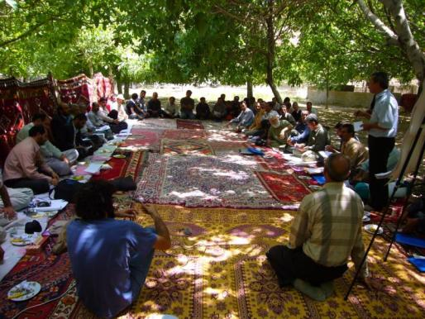
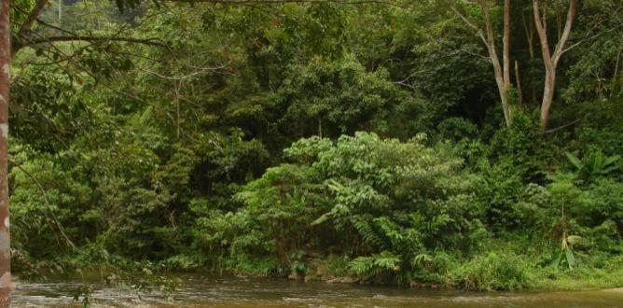
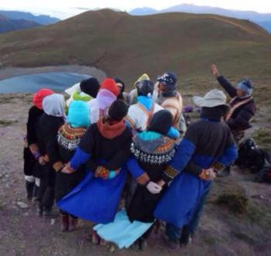
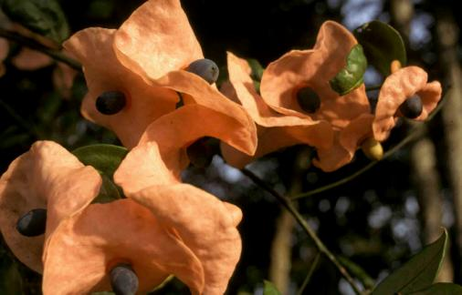
“ICCAs” is an abbreviation for:
Indigenous Peoples’ and Community Conserved Territories and Areas
(or the “seeds”, the “jewels”, the “heart”...
...of bio-cultural diversity around the world! )
Notes:
2
gbf

Slide 3
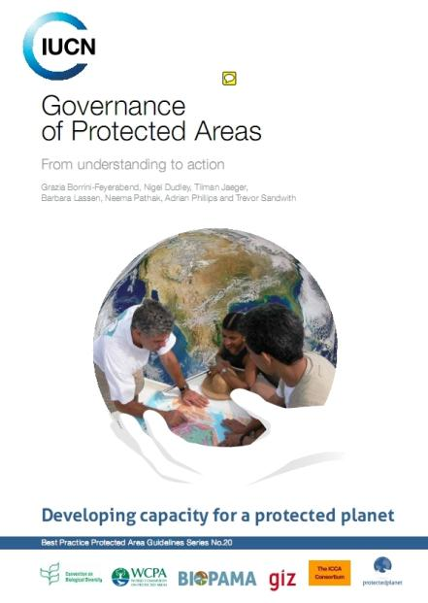
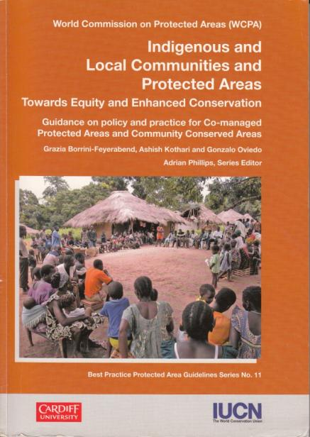
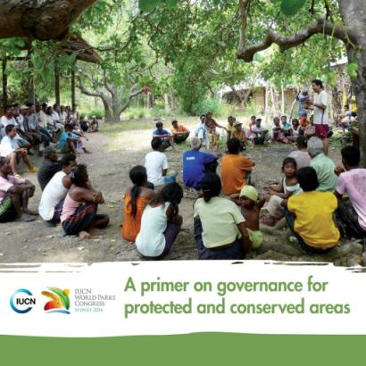
IUCN defines them as :
“natural and/or modified ecosystems, containing significant biodiversity values, ecological benefits and cultural values, voluntarily conserved by indigenous peoples and local communities, both sedentary and mobile, through customary laws or other effective means”.

Slide 4
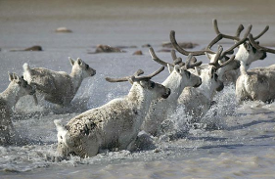
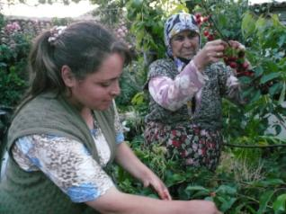
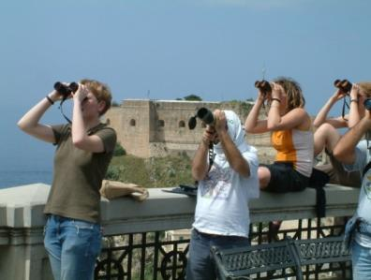
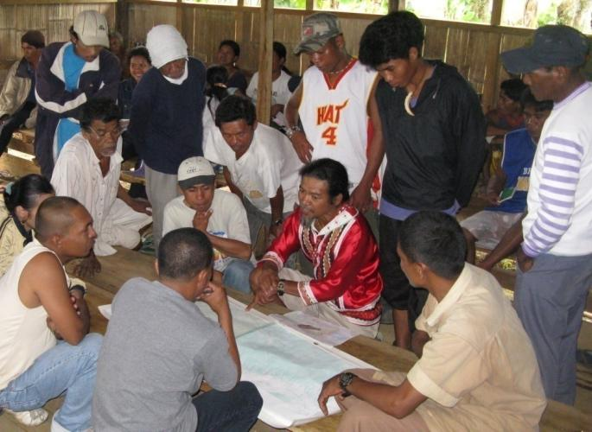
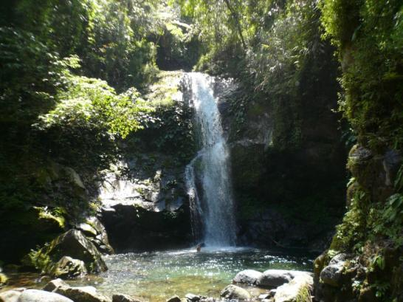
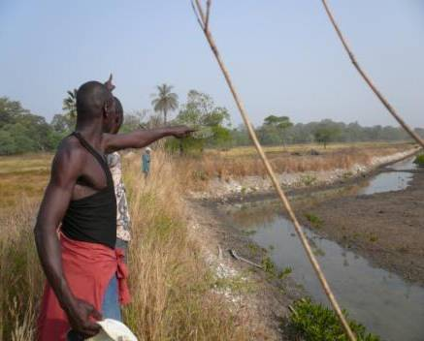
ICCAs are found everywhere, span all types of ecosystems and cultures, have thousands of local names and are extremely diverse…

Slide 5
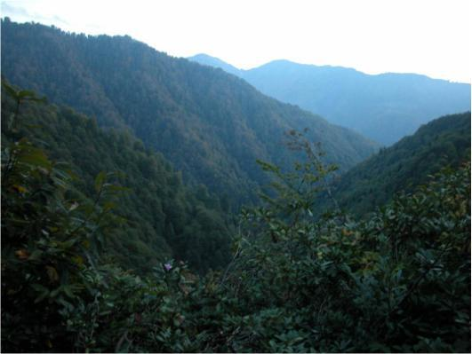
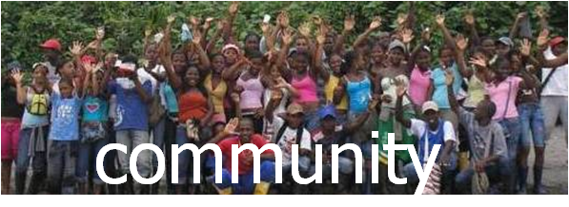
de facto capacity/power to take and enforce decisions (functioning governance institution)
2
… but they all have 3 characteristics
1
natural area/
territory
decisions & practices lead to
conservation of nature
(including sustainable use & restoration, positive trend)
3

Slide 6
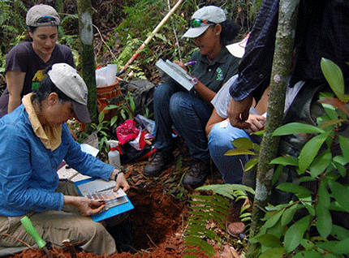
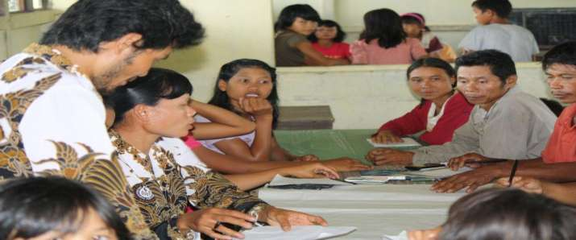
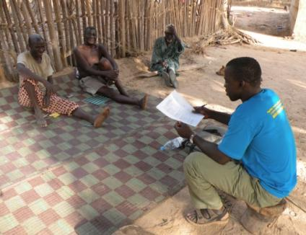
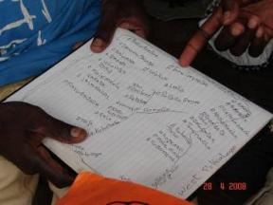
Assessing the conservation and livelihoods results and governance vitality of ICCAs
Supporting communities to self- monitor and communicate their ICCAs

Slide 7
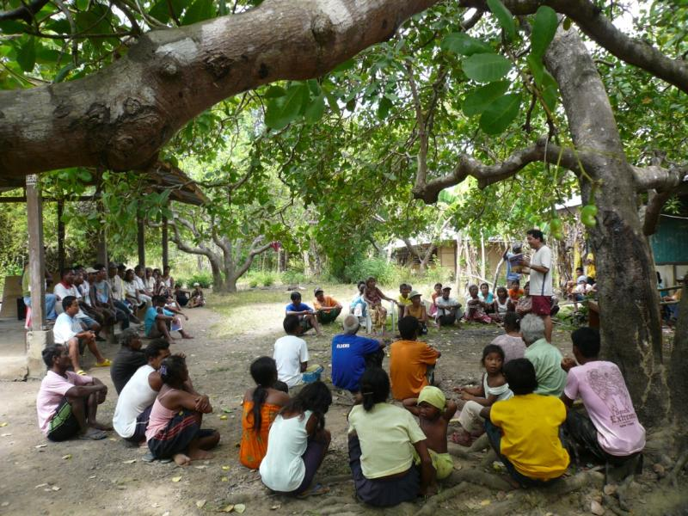
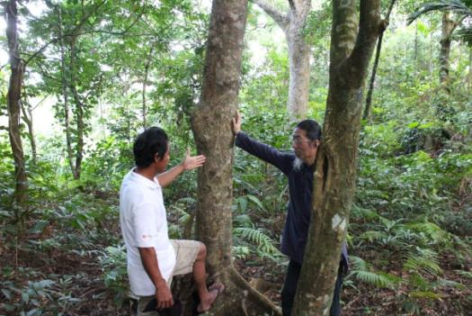
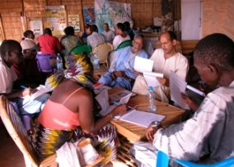
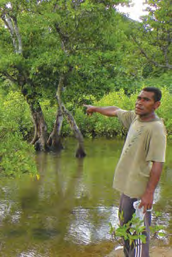
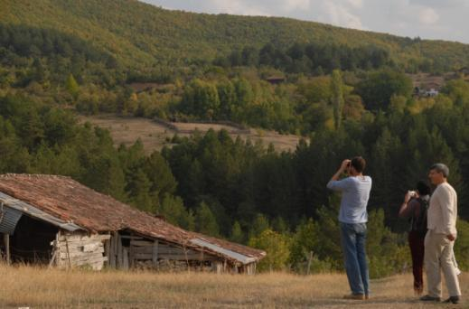
Methodology for grassroots discussions on ICCA
participatory process
adapted to the context
variety of combined methods and tools
discussion of the status of the ICCA, its eventual threats and needs &what kind of recognition and support it wishes to receive
Tested in 20 countries + 4 sub-regions

Slide 8
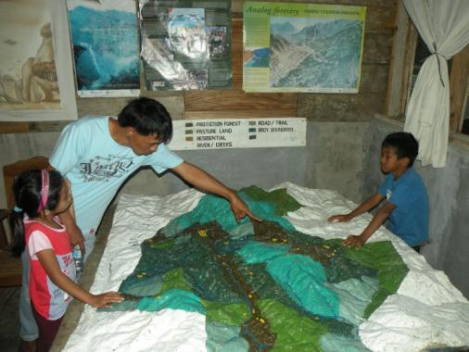
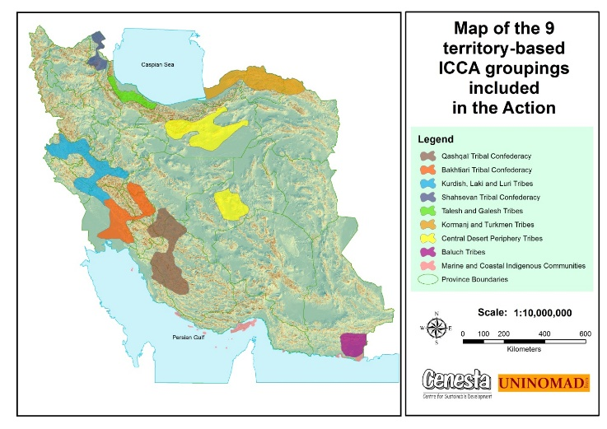
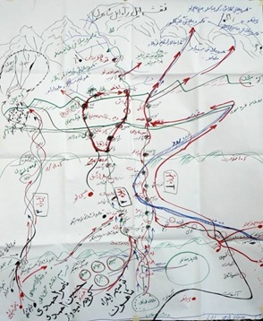
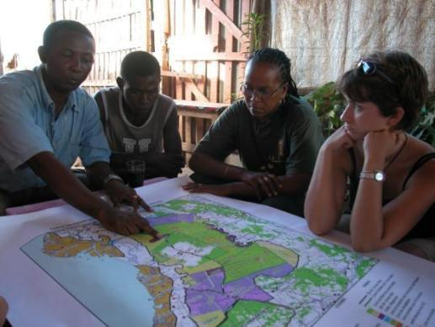
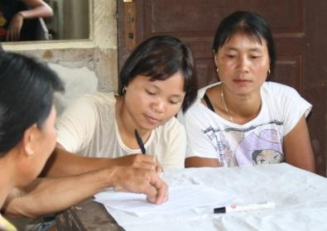
Visual tools: Mapping ICCAs 2D, 3D, use of Participatory Geographic Information Systems (PGIS)…
Applied in the grassroots discussions in Asia, Africa, America, Europe, Oceania…

Slide 9
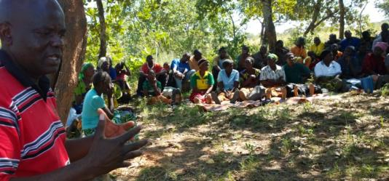
Resilience and security tool for ICCAs
Internal factors:
Connection between the IP/LC and its ICCA
Governance of the ICCA
Conservation of nature and sustainable livelihoods
Resilence and security versus internal threats
External factors:
Tenure and recognition
Balance between demanded and received support
Resilience and security versus external threats
Tested in a variety of languages in Senegal, Indonesia, Spain, the Philippines, Niger, Nepal…)

Slide 10
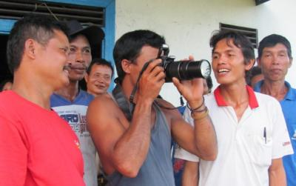
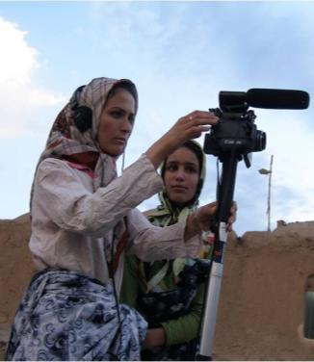
Participatory methodology for the development of Video and Photo stories on threats to ICCAs & community responses
Applied in India, Cambodia, Kenya, Nepal, Philippines, Bolivia, Chile….

Slide 11
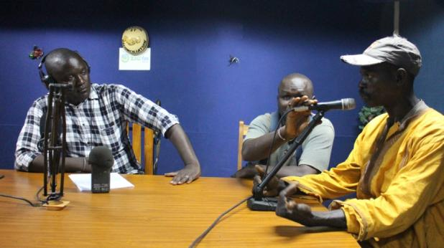
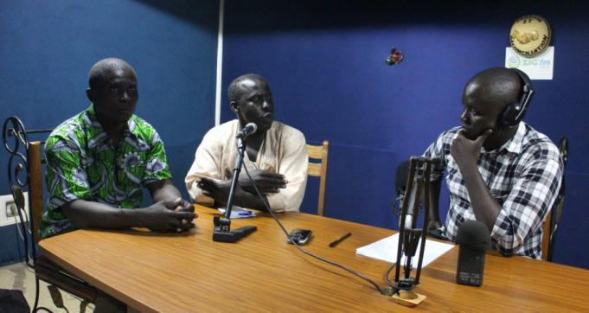
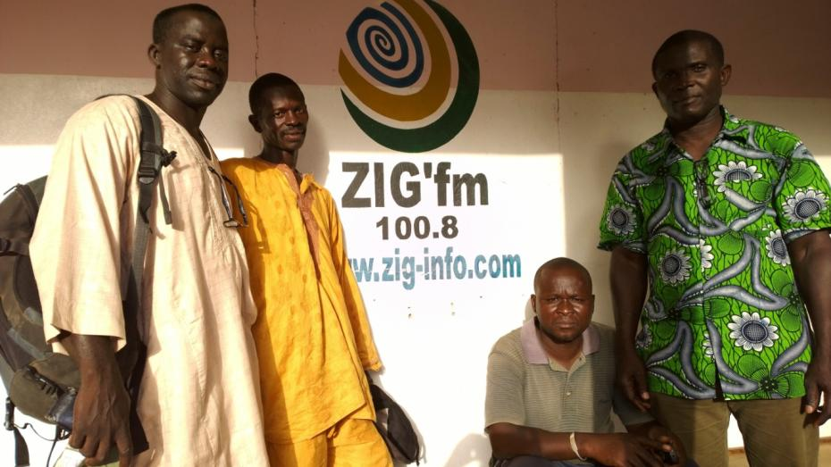
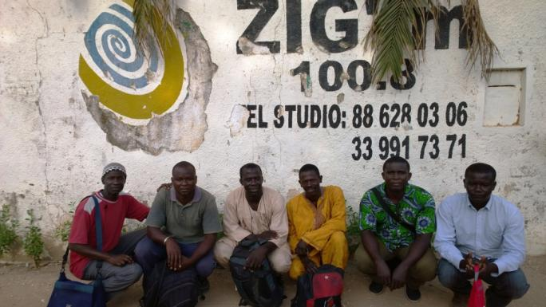
Interactive radio programs on ICCAs in local languages
Example in Casamance (Senegal) on-going now for several years

Slide 12
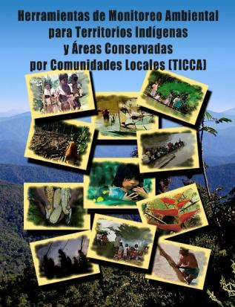
Environmental monitoring and threats assessment tools
A toolbox for ecosystem monitoring to empower indigenous peoples facing many threats (from extractive industries in particular)…
8 empowerment and training booklets
14 monitoring protocols
Developed and applied in Bolivia in 3 TCOs

Slide 13
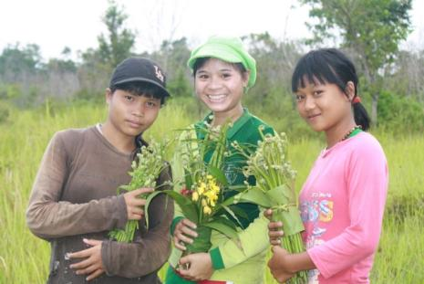
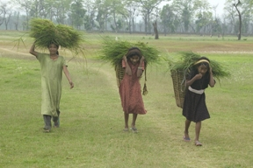
Biocultural Community Protocols:
A toolkit for Community facilitators
support for communities to secure their rights and responsabilities and strengthen customay ways of life and sterwardship of their territories and areas.
directed primarily towards facilitators from the communities themelves or from supporting organizations with whom they have long-standing and positive relationships.
Applied in Africa and Asia…

Slide 14
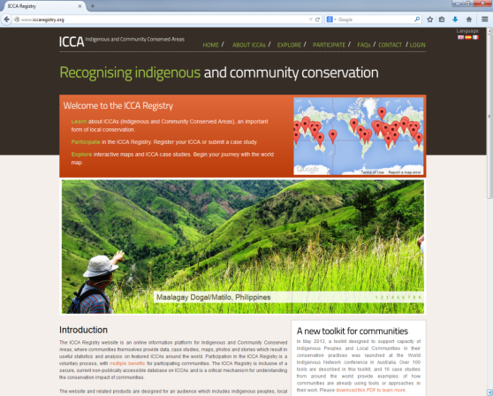
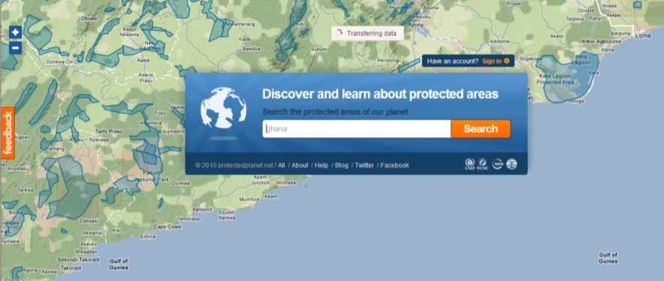

ICCA Registry
Established in 2009 and currently in process of being fully integrated with the protected planet database
170 registered ICCAs and many more coming
Website features 28 case studies from 11 countries
Free Prior Informed Consent (FPIC) process
Communities can send in their information directly, via a simple peer review process facilitated by national/ regional ICCA networks / coalitions/ federations, with advice from the ICCA Consortium and on the basis of some standard forms
The communities are the owners of the submitted information
The communities decide if the information is visible or hidden, and may withdraw it at any time

Slide 15
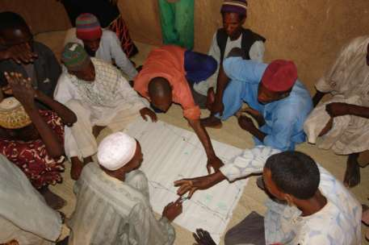
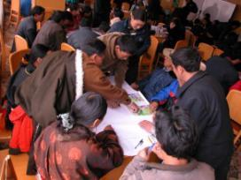
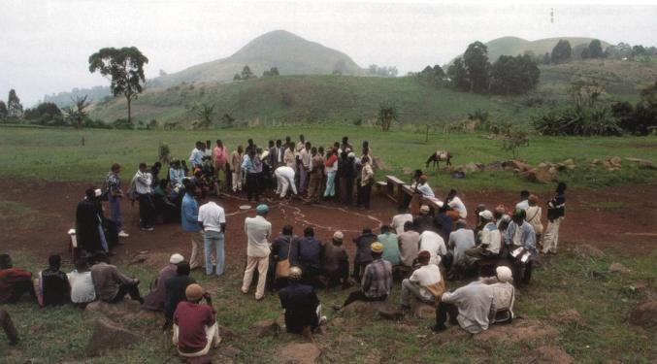
Lessons learned: appropriate methods, tools and interactions respect and strengthen communities and leave them:
better connected with their natural commons & more capable to govern and manage them well
fully aware of their own history & culture and able to govern themselves (self-determination)
richer in terms of resources, capital and infrastructure, and with more autonomy
stronger, more respected by others and better connected with other communities
with dependable friends and allies in civil society and in government quarters
wiser, more responsible and more capable to learn, innovate and prevent and solve problems

Slide 16
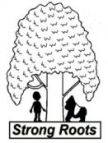



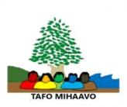





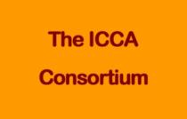





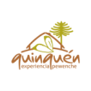























































Many thanks for your patience & sustained attention !
REPALEF-RDC
Associacion Indigena Mapu Lahual
www.ICCAconsortium.org
Bukluran Inc.) The Philippines
Consejo Shipibo Conibo Xetebo (Peru)
Vilar Woods Commons
EKURI INITIATIVE
ICCA Network Nepal
KEREIMBAS
UNICAMEL

